Slide 1
Housebill Sales
HCAD HB Sales

Slide 2
HCAD HB Sales
The purpose of the HB Sales is to provide the Sales comparison for Sales Team. The Housebill contains neighborhood sales that is provided from the county site.
We are using the HBExtractor Tool to process the HCAD HB Sales.

Slide 3
HCAD HB Sales
Source:
Previously we were running the Nightcrawler site to pull the records to process. If this process is running the housbill will automatically indexed to Paperwise (HB
If we are doing manually, download the records from Inspartaxx application based on Hearing Date (14 days ahead) from the current date.
Inspartaxx Link: http://inspartaxxapp/ClientSetup/MainScreenSearch/1

Slide 4
HCAD HB Sales
Generating Source Records:
The Source records should be downloaded from Inspartaxx Tool for both Informal & Formal Hearing.
Informal Hearing:
Open the Inspartaxx application.
Select the Report tab.
Select Hearing in the Category Name (Dropdown) & Hearing Accounts for Smartprep (Informal Hearing) from Report Name.
Select the County HCAD from field Name County
Provide the date in Informal Hearing Date field. (Date range should be 14 days above from the current date).
Click on the Generate Excel tab to download the file.
Open the downloaded file and remove the Inactive & Sold Records from the list.

Slide 5
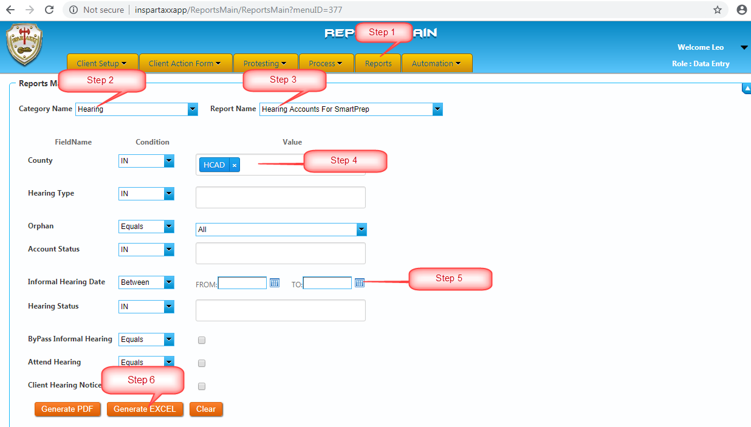

Slide 6
HCAD HB Sales
Formal Hearing:
Open the Inspartaxx application.
Select the Report tab.
Select Hearing in the Category Name (Dropdown) & Formal Hearing Schedule (Formal Hearing) from Report Name.
Provide the date in Formal Hearing Date field. (Date range should be 14 days above from the current date).
Select the County HCAD from field Name County
Click on the Generate Excel tab to download the file.

Slide 7
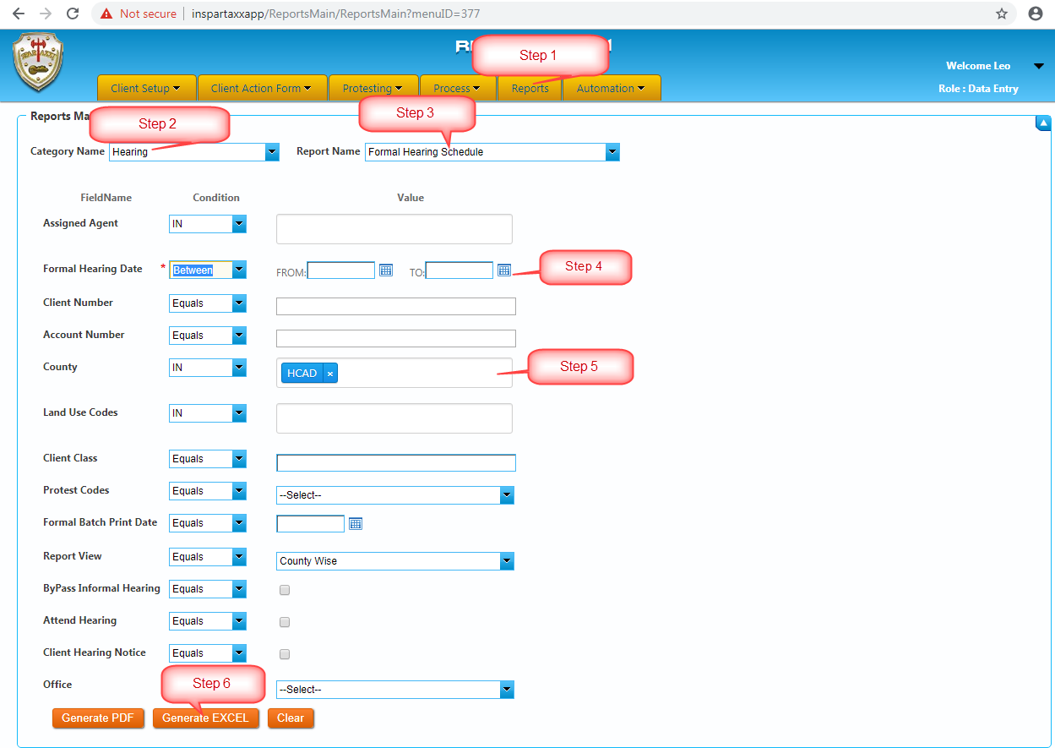

Slide 8
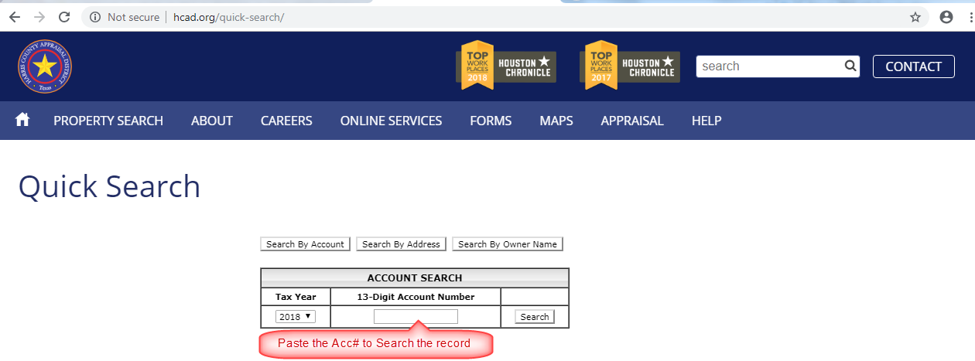
HCAD HB Sales
Downloading Process:
Generate the AgentID for all the Accounts from the CAD Site.
Cad Site Link: http://hcad.org/quick-search/

Slide 9
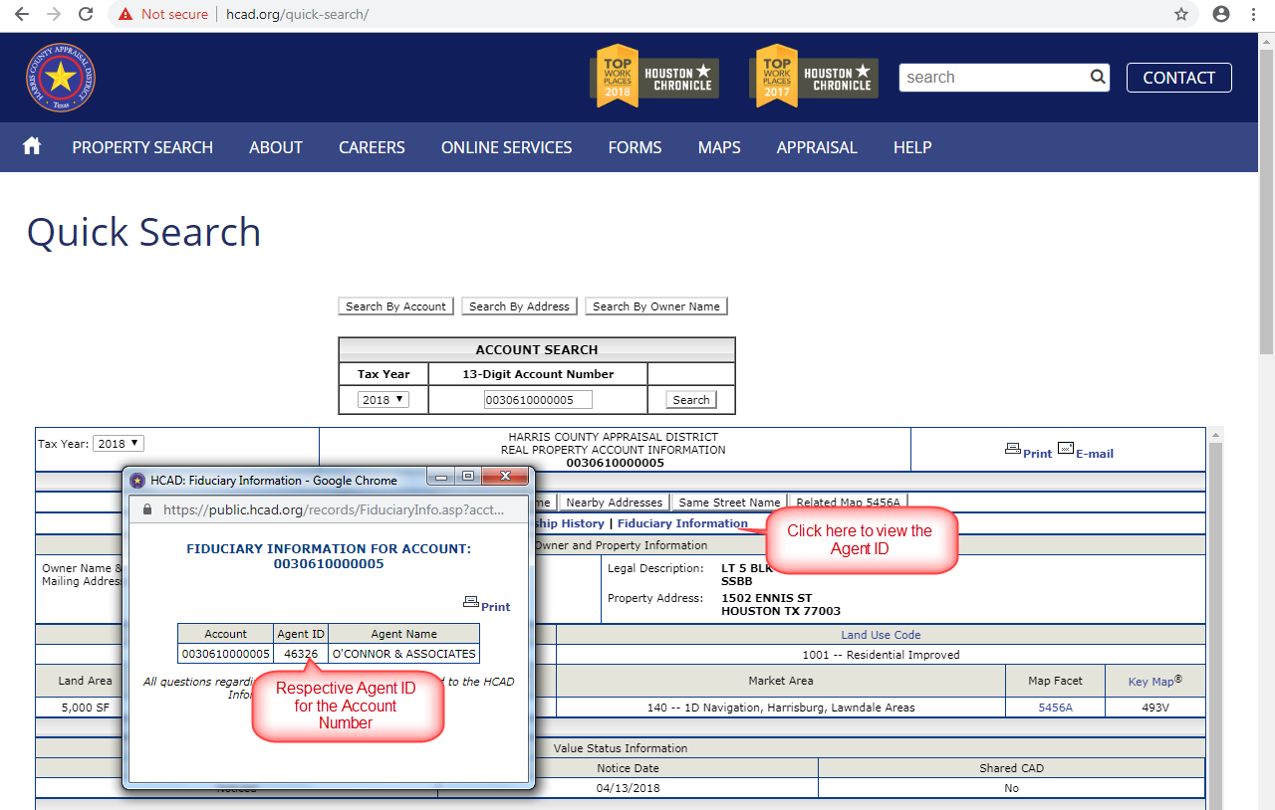

Slide 10
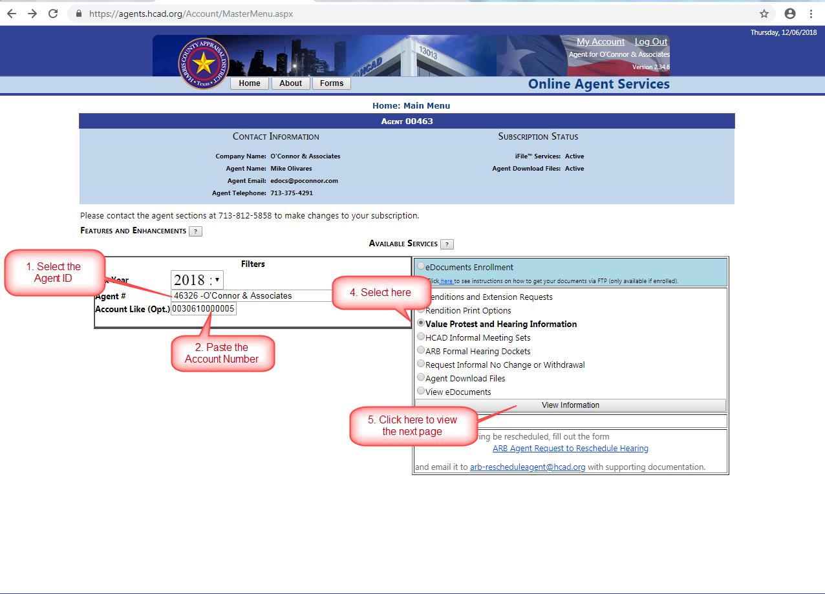
HCAD HB Sales
Select the respective agent id, paste the Account Number & Select Value Protest & Hearing Information in the Check box and View the information. As shown below

Slide 11
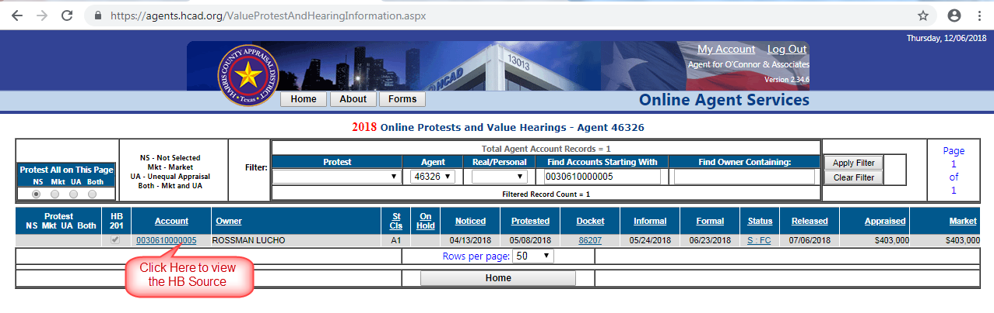
HCAD HB Sales
Click the Account Number to view the Housebill page.

Slide 12
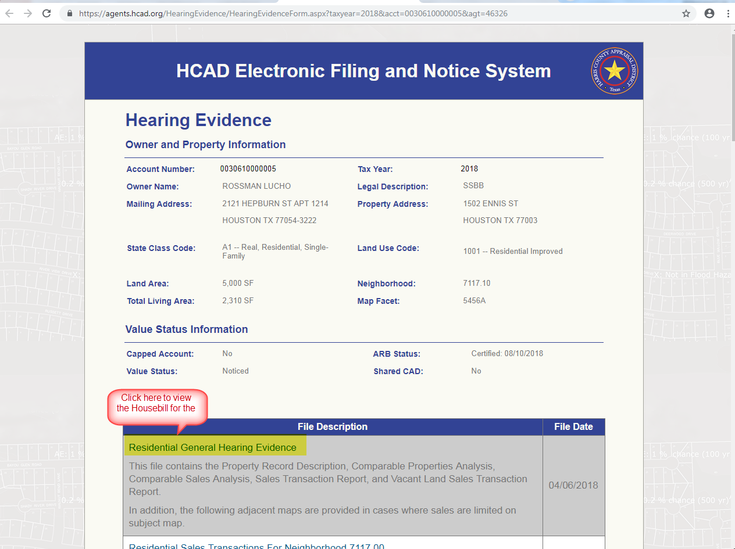
HCAD HB Sales
Click the Hearing Evidence Link to View the Housebill

Slide 13
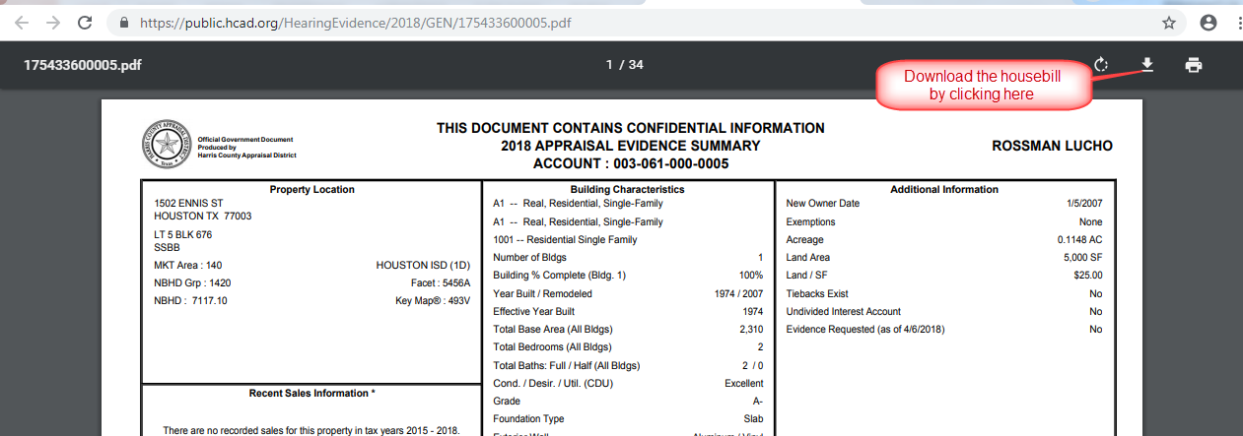
HCAD HB Sales
Download the housebill once the page viewed as shown below.

Slide 14
HCAD HB Sales
Indexing:
Once the downloading process has done provide the downloaded documents to Respective Programming to Index the housebill to Paperwise. If this task is completed we can able to view the production file from the HB Extractor Tool.

Slide 15
HCAD HB Sales
Processing in HB Extractor Tool
Open the HB Extractor Tool
Extract the Records from Tool as per the Scan Date.
Once the Records Extracted, Go to the Sale Data page & Select the respective batch ID to view the Sales belongs to Extracted Accounts.
Download all the sales type to work, and validate the required fields as shown below.

Slide 16
HB Extractor Tool Screenshot to be added

Slide 17
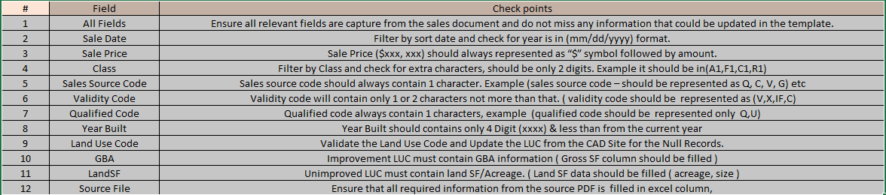
Required Fields to Validate

Slide 18

HCAD HB Sales
Update the Source as CAD, Source 2 as CAD & Source Group ID as CAD – PTAX.
Update the Film Code for the Null Accounts as “OCA” followed by the account number.
Click the below document to view the sample record.
Once Validated the record, upload the file HB Extractor Sales Uploader. Ensure to click the Source from Housebill before loading.

Slide 19
Uploading screenshot to be added

